Slide 1
Low-level feature extraction (including edge detection)
Chapter 4 Feature extraction in computer vision by Nixon

Slide 2
HoG Canny
Edge Detection

Slide 3
Image Features

Slide 4
Low Level Features
Low-level features to be those basic features that can be extracted automatically from an image without any shape information (information about spatial relationships)
High Level features ??
Difference?

Slide 5
Feature Descriptor
A feature descriptor captures essential information about the features of an image, helping in tasks like object detection.

Slide 6
Why edges?
Resilience to lighting and color
useful for recognition, matching patches across images

Slide 7
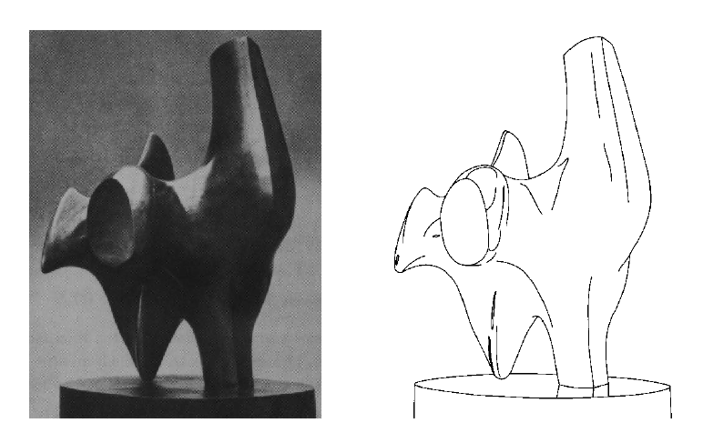
Why edges?
Humans are sensitive to edges
Convert a 2D image into a set of curves
Extracts salient features of the scene, more compact
TexPoint fonts used in EMF.
Read the TexPoint manual before you delete this box.: AAA

Slide 8
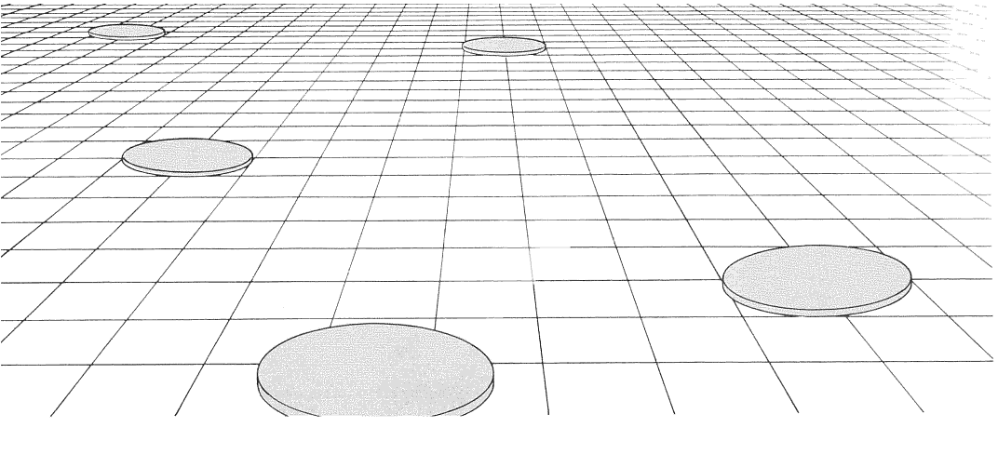
Why edges?
Cue to shape and geometry
useful for recognition, understanding 3D structure
Credit: Jitendra Malik
Credit: Attneave

Slide 9
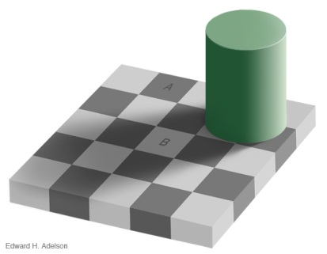
Edges
Edges are curves in the image, across which the brightness changes “a lot”
Corners/Junctions
Notes:
Reflectance edges
Shadow edges
Depth edges
Normal edges

Slide 10
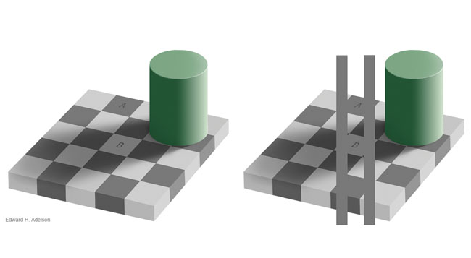
Aside

Slide 11
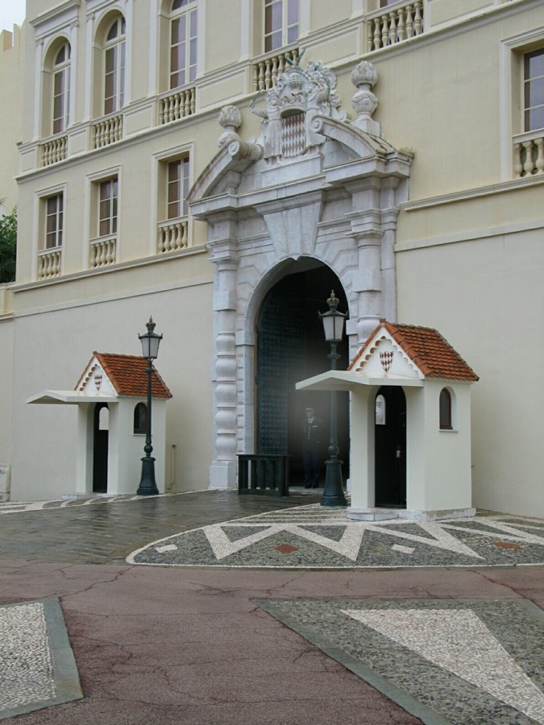
Closeup of edges
Source: D. Hoiem

Slide 12

Close-up of edges
Source: D. Hoiem

Slide 13

Closeup of edges
Source: D. Hoiem

Slide 14
Edge detection is a technique to identify points in an image where the brightness changes sharply.
Moreover, it can be applied for image segmentation.

Slide 16
Edge detection is insensitive to change in the overall illumination level.
Edge detection highlights image contrast. Detecting contrast, which is difference in intensity, can emphasize the boundaries of features within an image, since this is where image contrast occurs.
Essentially, the boundary of an object is a step change in the intensity levels. The edge is at the position of the step-change. We can use first-order differentiation to detect the edge position since this emphasizes change; first order differentiation gives no response when applied to signals that do not change.
Differencing horizontally adjacent points will detect vertical changes in intensity and is often called a horizontal edge detector by its action. A horizontal operator will not show horizontal changes in intensity since the difference is zero.

Slide 17
A feature descriptor is a representation of an image or an image patch that simplifies the image by extracting useful information and throwing away extraneous information.

Slide 18
A feature descriptor converts an image of size width x height x 3 (channels ) to a feature vector / array of length n. In the case of the HOG feature descriptor, the input image is of size 64 x 128 x 3 and the output feature vector is of length 3780.

Slide 19
How to calculate Histogram of Oriented Gradients ?

Slide 20
HOG is a feature descriptor that counts occurrences of gradient orientation in localized portions of an image.

Slide 21
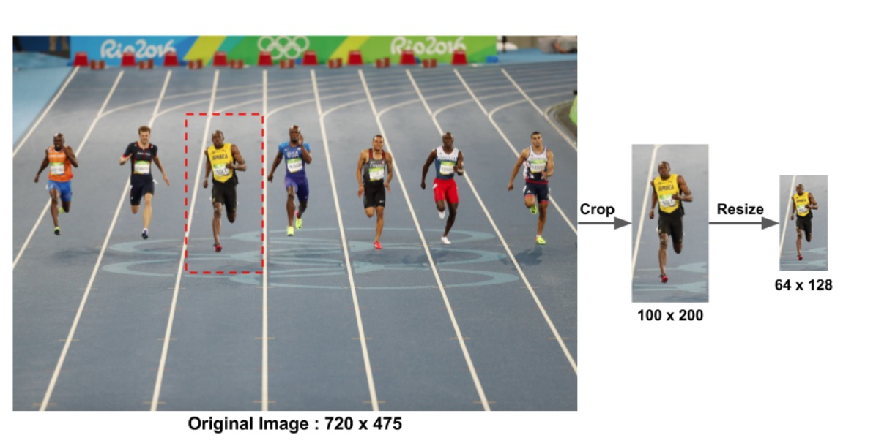
1-Pre-Processing

Slide 22
Pre-processing
Resize and
Gaussian Blurring

Slide 23
Gradient of a Line
The gradient of a line is the measure of the steepness of a straight line.
The gradient of a line can be either positive or negative and does not need to be a whole number.
The gradient of a line can either be in an uphill (positive value) or downhill direction (negative value).

Slide 24
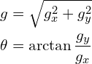
Find the magnitude and direction of gradient using the following formula

Slide 25
Step 2 : Calculate the Gradient Images
Calculate the horizontal and vertical gradients
Change in X and Y direction
Calculate Gx and Gy using Sobel operator (Read How: https://automaticaddison.com/how-the-sobel-operator-works/)

Slide 26
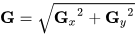
Gradient Magnitude
Gradient magnitude refers to the strength of an image’s intensity change.

Slide 27
Gradient Orientation
Therefore, the gradient orientation is computed using the following equation:

Slide 28
Step 3 : Calculate Histogram of Gradients in 8×8 cells
the image is divided into 8×8 cells and a histogram of gradients is calculated for each 8×8 cells.

Slide 29
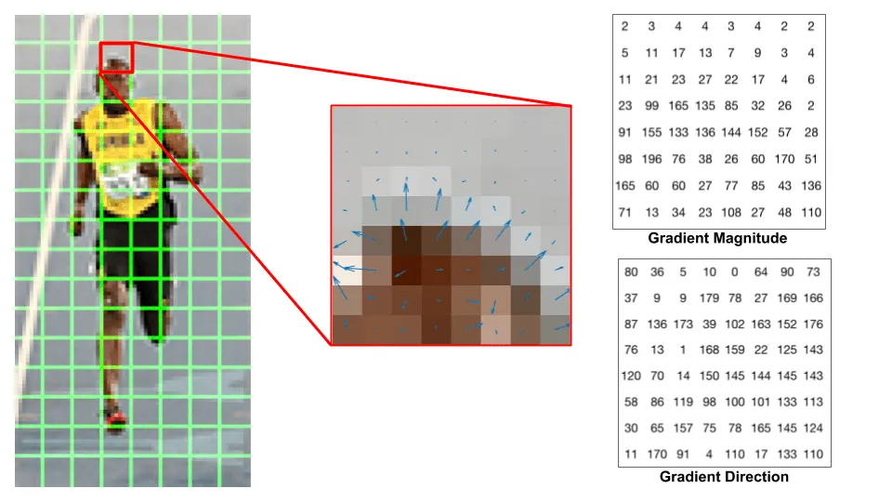

Slide 30
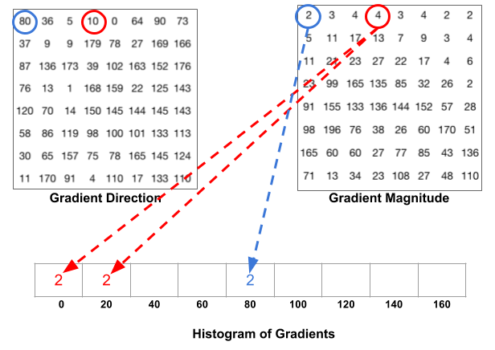
Histogram-Binning
In this method: proportional weights of magnitude are allocated to each bin
For orientation/direction =36
How to Distribute Magnitude = 3
(40 - 36)/20*3= 4/20 *3 = 2 (goes to Bin 20)
(36- 20 )/20*3 = 16/20 *3 = 2.4 (goes to bin 40) Since 36 is more closer to 40
Divided by 20, since size of each bin is 20
Other Methods: https://www.analyticsvidhya.com/blog/2019/09/feature-engineering-images-introduction-hog-feature-descriptor/

Slide 31
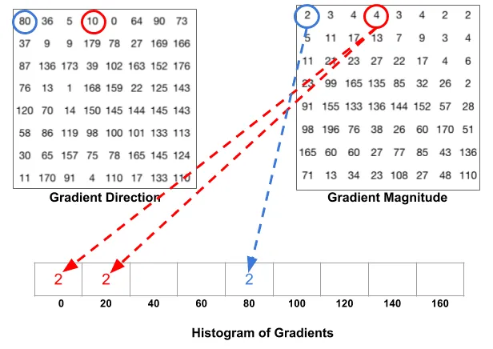
Since 10 degrees is half way between 0 and 20, the vote by the pixel splits evenly into the two bins.

Slide 32
If the angle is greater than 160 degrees, it is between 160 and 180, and we know the angle wraps around making 0 and 180 equivalent. So in the example below, the pixel with angle 165 degrees contributes proportionally to the 0 degree bin and the 160 degree bin.

Slide 33
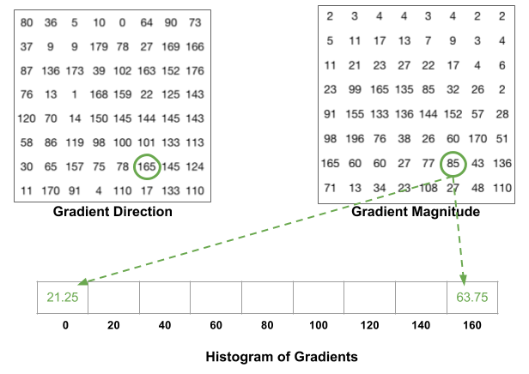
(165-160)/20 * 85 = 21.25 (goes to bin 0 ) (180-165)/20 * 85 = 63.78 ( goes to bin 160 – since it has more weight

Slide 34
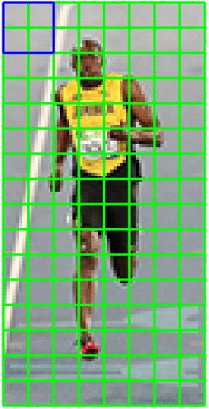
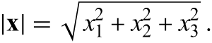
Step 4 : 16×16 Block Normalization
Calculate L2 Norm of a Vector
Dividing each element of this vector by L2 Norm

Slide 35
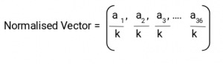
Normalization
Mathematically, for a given vector V:
V = [a1, a2, a3, ….a36]
We calculate the root of the sum of squares:
k = √(a1)2+ (a2)2+ (a3)2+ …. (a36)2
And divide all the values in the vector V with this value k:
To normalize this matrix, we will divide each of these values by the square root of the sum of squares of the values.

Slide 36
Step 5 : Calculate the Histogram of Oriented Gradients feature vector
To calculate the final feature vector for the entire image patch, the 36×1 vectors are concatenated into one giant vector. What is the size of this vector ? Let us calculate
How many positions of the 16×16 blocks do we have ? There are 7 horizontal and 15 vertical positions making a total of 7 x 15 = 105 positions.
Each 16×16 block is represented by a 36×1 vector. So when we concatenate them all into one giant vector we obtain a 36×105 = 3780 dimensional vector.

Slide 37
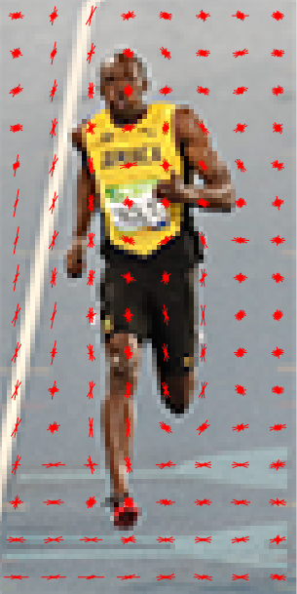
Visualization of HoG

Slide 39
Other Methods
Canny Edge Detection

Slide 40
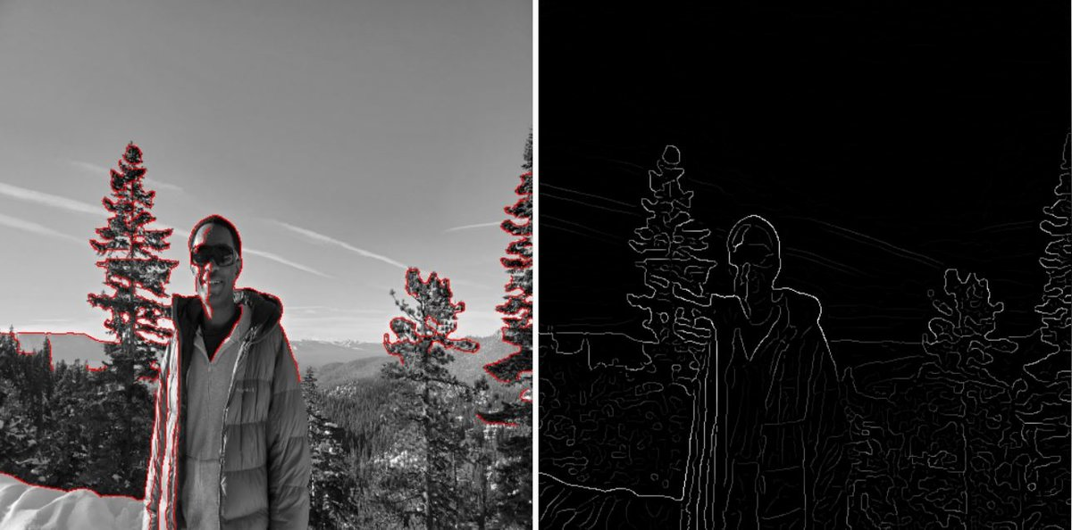
The Canny Edge Detector Process is as follows:
Gaussian Filter: Smooth the input image with a Gaussian filter to remove noise (using a discrete Gaussian kernel).
Calculate Intensity Gradients: Identify the areas in the image with the strongest intensity gradients (using a Sobel, Prewitt, or Roberts kernel).
Non-maximum Suppression: Apply non-maximum suppression to thin out the edges. We want to remove unwanted pixels that might not be part of an edge.
Thresholding with Hysteresis: Hysteresis or double thresholding involves:
Accepting pixels as edges if the intensity gradient value exceeds an upper threshold.
Rejecting pixels as edges if the intensity gradient value is below a lower threshold.
If a pixel is between the two thresholds, accept it only if it is adjacent to a pixel that is above the upper threshold.

Slide 41
Reference
https://learnopencv.com/histogram-of-oriented-gradients/

